Slide 1

Introduction to Android
Copyright© Jeffrey Jongko, Ateneo de Manila University

Slide 2
Overview
What is Android?
Features
Architecture
Runtime: Dalvik VM
Linux Kernel
Under the Hood
Java, Eclipse, Android SDK Installation
New Project Creation
Project Folder Hierarchy
Very Simple Lab Exercises

Slide 3
What is Android?
software stack for mobile devices
  operating system
  middleware
  key applications
Android SDK
  contains tools and APIs necessary to begin developing applications on the Android platform using the Java programming language.

Slide 4
Android Features
Application framework enabling reuse and replacement of components
Dalvik virtual machine optimized for mobile devices
Integrated browser based on the open source WebKit engine
Optimized graphics powered by a custom 2D graphics library; 3D graphics based on the OpenGL ES 1.0 specification (hardware acceleration optional)
SQLite for structured data storage

Slide 5
Android Features
Media support for common audio, video, and still image formats (MPEG4, H.264, MP3, AAC, AMR, JPG, PNG, GIF)
GSM Telephony (hardware dependent)
Bluetooth, EDGE, 3G, and WiFi (hardware dependent)
Camera, GPS, compass, and accelerometer (hardware dependent)
Rich development environment including a device emulator, tools for debugging, memory and performance profiling, and a plugin for the Eclipse IDE

Slide 6
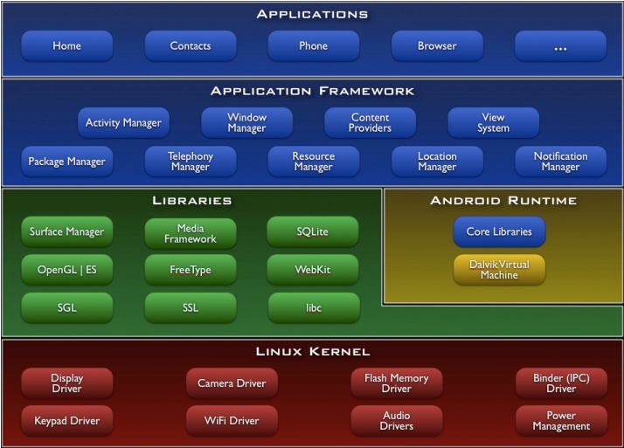
Android Architecture

Slide 7
Android Runtime: Dalvik VM
Android Virtual Machine (VM) = Dalvik
Every Android app runs in its own process, with its own instance of the Dalvik VM.
The “dx” tool (from the Android SDK) translates Java classes compiled by a Java Language compiler into “.dex” (Dalvik Executable) format.
“.dex” files are zipped into a single “.apk” (Android application package) file

Slide 8
Android: Linux Kernel
Uses Linux version 2.6
  Core System Services
    Security
    Memory management
    Process management
    Network stack
    Driver model

Slide 9
Eclipse IDE– making OOP Easy

Slide 10
Object-Oriented Programming
Revisited
Key OOP Concepts
  Object, Class
  Instantiation, Constructors
  Encapsulation
  Inheritance and Subclasses
  Abstraction
  Reuse
  Polymorphism, Dynamic Binding
Object-Oriented Design and Modeling

Slide 11
Object
Definition: a thing that has identity, state, and behavior
  identity: a distinguished instance of a class
  state: collection of values for its variables
  behavior: capability to execute methods
  * variables and methods are defined in a class

Slide 12
Class
Definition: a collection of data (fields/ variables) and methods that operate on that data
  define the contents/capabilities of the instances (objects) of the class
  a class can be viewed as a factory for objects
  a class defines a recipe for its objects

Slide 13
POJO and JavaBeans
POJO
  Stands for Plain Old Java Object
Naming Conventions
  Class name - Start with a capital letter
  Private fields + getters and setters
    Fields start with small letter
    Camel case
  Singular form

Slide 14
POJO and JavaBeans
JavaBean
  A POJO that follows the following criteria
    Has a blank constructor
    Has a get/set method for all private fields
      E.g. a field int count has a
        int getCount()
        setCount(int)

Slide 15
Instantiation
Object creation
Memory is allocated for the object’s fields as defined in the class
Initialization is specified through a constructor
  a special method invoked when objects are created

Slide 16
Encapsulation
A key OO concept: “Information Hiding”
Key points
  The user of an object should have access only to those methods (or data) that are essential
  Unnecessary implementation details should be hidden from the user
  In Java/C++, use classes and access modifiers (public, private, protected)

Slide 17
Inheritance
Inheritance:
  programming language feature that allows for the implicit definition of variables/methods for a class through an existing class
Subclass relationship
  B is a subclass of A
  B inherits all definitions (variables/methods) in A

Slide 18
Abstraction
OOP is about abstraction
Encapsulation and Inheritance are examples of abstraction
  What does the verb “abstract” mean?

Slide 19
Polymorphism
“Many forms”
  allow several definitions under a single method name
Example:
  “move” means something for a person object but means something else for a car object
Dynamic binding:
  capability of an implementation to distinguish between the different forms during run-time

Slide 20
Interfaces
Essentially a “contract” stating a list of methods
  e.g. ActionListener -> require method actionPerformed(ActionEvent e)
  Implementing an interface tells the world that you have the methods defined in the interface

Slide 21
Eclipse – refactoring tools

Slide 22
Eclipse Tools
One of the main problem with OOP development is maintaining classes when there are changes
Eclipse has several automated tools that greatly aid OOP development
  Source generation – Source Menu
  Refactoring – Refactor Menu

Slide 23
Source tools
Source tools can help add boilerplate code
  Generate getter/setter
  Delegate methods
Override/implement methods
  Automatically creates stubs for interface/abstract methods
Several Misc tools
  Surrounding with try-catch, loops, etc.

Slide 24
Refactor tools
Refactor tools are used to do large scale code editing
  Things that would have normally been done using cut-and-paste
  Much more reliable, you can’t forget anything
  And best of all, you can Ctrl-Z to undo everything

Slide 25
Examples
General
  Renaming variables
  Extracting local variables or constants
  Inlining
OOP specific
  Encapsulate field
  Extract interface/superclass
  Introducing “parameter objects”
  Moving methods around an inheritance hierarchy
  Moving inner classes to top-level

Slide 26
Some things to remember:
Java for-each
List<DataType> objects = new
ArrayList<DataType>();
for(DataType o : objects ) { }

Slide 27
Packages
package com.foo.datawarehouse;
  Convention:
    com → commercial
    foo → company name
    datawarehouse → project name
E.g. edu.admu.cs1193

Slide 28
HelloWorld

Slide 29
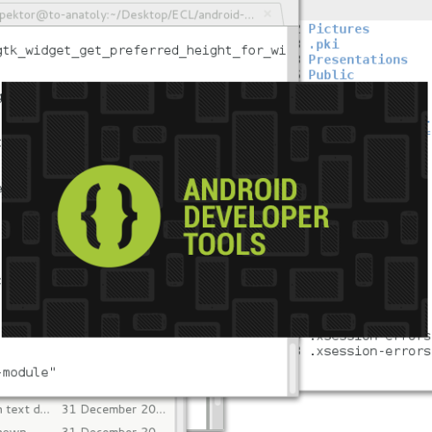
ADT
Android Developer Tools is an Eclipse-based tool that pre-installs the Android SDK with the latest emulator and SDK version

Slide 30

New Project Creation
In Eclipse ADT, select File > New > Project
Select Android > Android Project

Slide 31
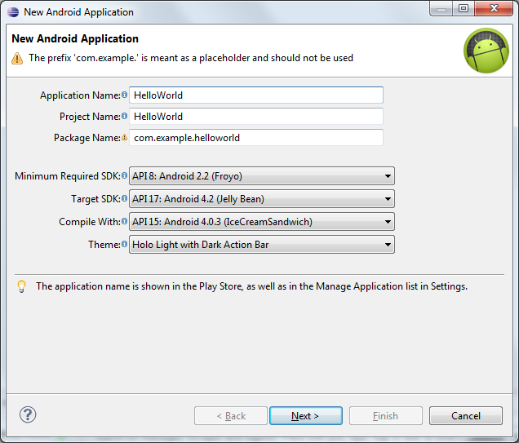
Give your application a name
A package name is automatically defined you may change this as needed
  You must have a package
Select what API level you wish to use

Slide 32
New Project Creation: Properties
Application name = title of application; will appear on
Android device
Package name = where src will reside; must have at least 2 components (i.e. 1 dot)
Create Activity = optional; name of your main Activity class
Min SDK Version = minimum API level to run your app; If
unsure, use API level in Build Target

Slide 33
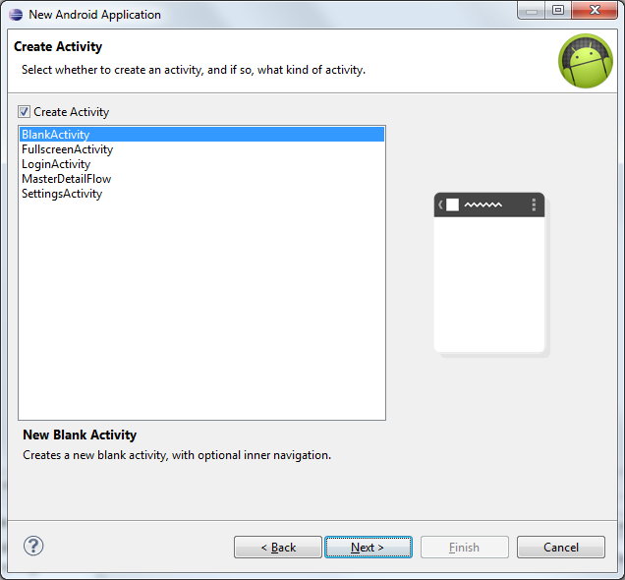
HelloWorld
Keep hitting Next till you get this screen and make sure “Blank Activity” is selected
This will create the default HelloWorld app

Slide 34
Running Helloworld – The Emulator

Slide 35
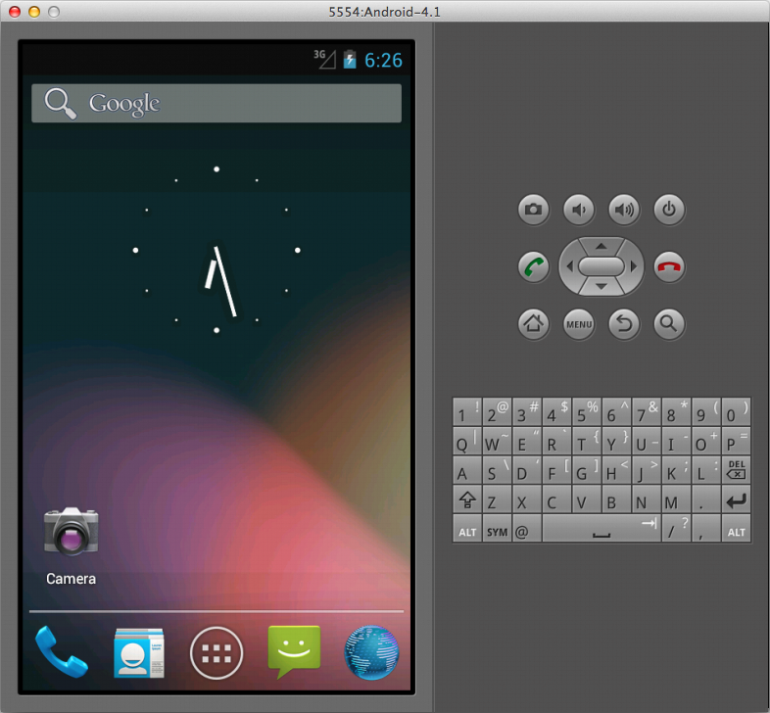
The Emulator
An emulator is a program that runs within your development machine that tries to act like a real device
“Tries” because not all functionality of Android is in the emulator

Slide 36
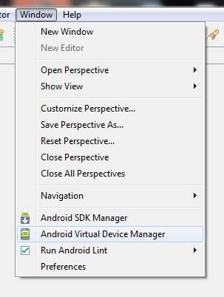
Creating an AVD
You need to define emulators, aka Android Virtual Devices in order to use them
Window → Android Virtual Device Manager

Slide 37
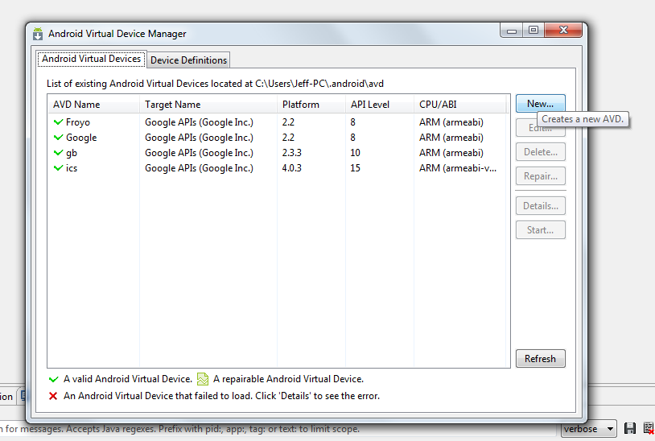
Creating an AVD
Select New.. To create a new AVD
You may also manage existing AVDs here

Slide 38
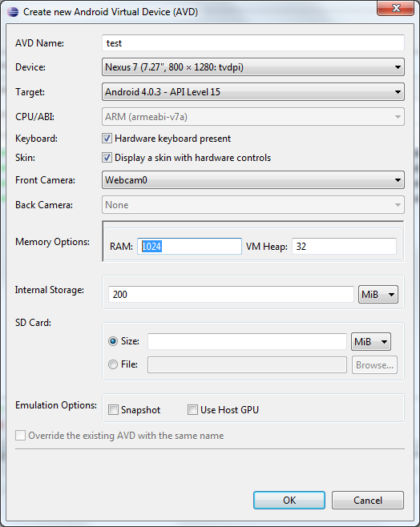
Creating an AVD
Give the emulator a name and select what screen size and API level it is supposed to have
Hit OK

Slide 39
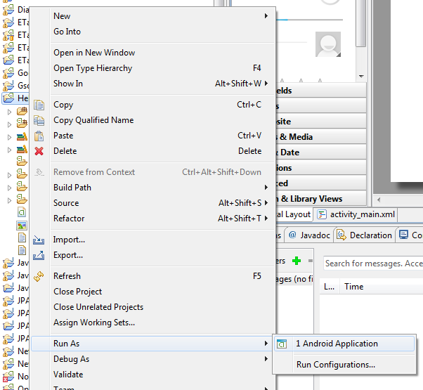
Starting the Emulator
Once you have an emulator defined you may then run your Android project
Right click the project → Run As → Android Application

Slide 40
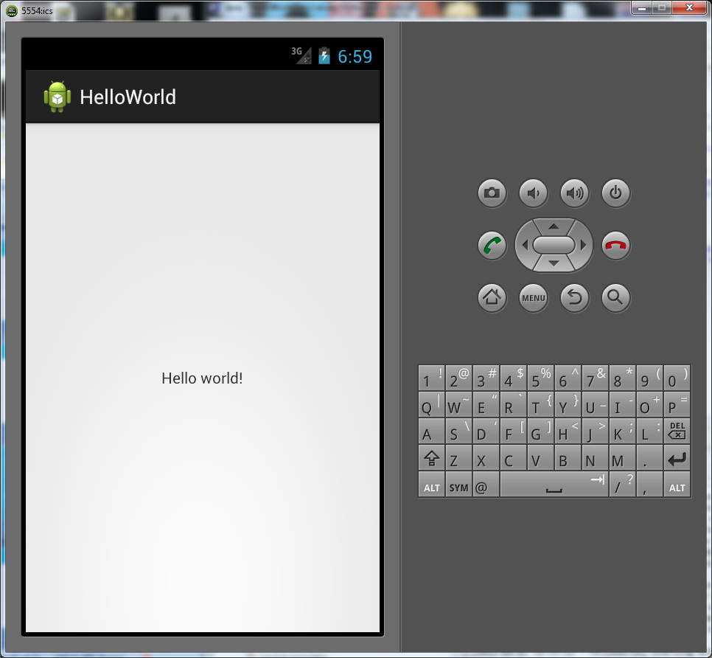
Hello World

Slide 41
Side Note
Emulators can be very slow and rather unresponsive compared to an actual device
  It can take several minutes to start the emulator
Whenever you can, it is preferable to debug your program on device
  However, this might not be possible, e.g. you want to see how your app looks in a 7” tablet, but you don’t have one

Slide 42
Deconstructing HelloWorld
Copyright© Jeffrey Jongko, Ateneo de Manila University

Slide 43
Overview
Deconstructing HelloWorld
User Interface
View Hierarchy
Layout (XML)
Load XML Resource
Layout (Output)
Widgets

Slide 44
Typical Android Applications
Typical Android applications are composed of 4 main parts
  Code definition
  UI definition
  Values definition
  Manifest definition
Each portion resides in a different part of the folder hierarchy

Slide 45
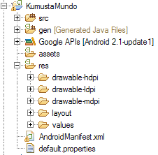
Android Project Folder Hierarchy
- where all your java source code resides

Slide 46
Android Project Folder Hierarchy
- contains R.java
- auto-generated
- short-hand way to refer to res
- DO NOT EDIT MANUALLY!

Slide 47
Android Project Folder Hierarchy
contains files (.txt files, etc) that you can’t put in the res folder.
* res folder contains images (PNG, JPEG, etc) and XML.
You can only READ data in the asset folder, not overwrite or add stuff during runtime

Slide 48
Android Project Folder Hierarchy
contains XML files that indicate
what your app looks like
each XML file could have
TextViews, Buttons, etc

Slide 49
Android Project Folder Hierarchy
may contain XML files (e.g.
strings, styles)
putting string values inside
string.xml file makes it easier to
localize/change to other foreign
languages
- styles ≈ css

Slide 50
Android Project Folder Hierarchy
contains details about the app
(Android version, etc), the
Activities used, permissions, etc

Slide 51
HelloWorld
package edu.ateneo.ajwcc.android;
import android.app.Activity;
import android.os.Bundle;
public class KumustaMundoActivity extends Activity {
/** Called when the activity is first created. */
@Override
public void onCreate(Bundle savedInstanceState) {
super.onCreate(savedInstanceState);
setContentView(R.layout.main_layout);
}
}

Slide 52
Not much there is there…
Majority of Android’s UI definition is done using XML files
  Allows clean separation between the UI design and the code
Code’s main job is to store control logic
  Widget event-handling code
  Activity Life Cycle methods (like onCreate)

Slide 53
HelloWorld XML Layout
<?xml version="1.0" encoding="utf-8"?>
<LinearLayout xmlns:android="http://schemas.android.com/apk/res/android"
android:orientation="vertical"
android:layout_width="fill_parent"
android:layout_height="fill_parent"
>
<TextView
android:layout_width="fill_parent"
android:layout_height="wrap_content"
android:text="@string/hello"
/>
</LinearLayout>
Found in the
res > layout folder

Slide 54
Android: User Interface
Built using View and ViewGroup objects
View = base for subclasses called widgets
  Widgets = text fields, buttons, etc
ViewGroup = base for subclasses called layouts
  Layouts = linear, tabular and relative (layout architectures)

Slide 55
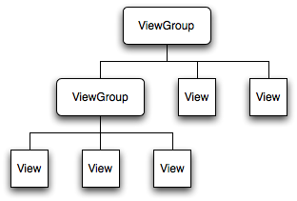
Android: View Hierarchy
To attach View Hierarchy to the screen (for rendering), must call setContentView() in your Activity.
Android parses hierarchy tree from the top
In case of overlaps, Draw Order = “last one to be drawn will lie on top of others previously drawn to that space”

Slide 56
Android: Declaring UI Layout
2 ways:
  “Declare UI elements in XML”
  “Instantiate layout elements at runtime” (programmatically)
You can use either or both!
Advantage in using both:
  XML can handle presentation (and use the UI Designer for drag-and-drop)
  Code can handle behavior of UI elements (ala Controller in MVC)

Slide 57
Widgets
Android has many widgets (simple and complex) built-in to it
  Buttons
  Textfields
  ListView
  ImageViews
Each widget has a programmatic and XML representation

Slide 58
Layouts
Android has many layouts (simple and complex) built-in to it
  Linear
  Relative
  Tabular
Like widgets, each layout has a programmatic and XML representation

Slide 59
More Later
Specific Widget and Layouts will be discussed later in a separate slideset
Additional information can also be found in the Android documentation found with the SDK

Slide 60
values
Hard-coded strings are never a good thing in an application
  Hard to change especially if used in several places
  Forces a recompile of the application
    NOT GOOD
  Used for text localization
    Changing text for different languages

Slide 61
Strings.xml
<?xml version="1.0" encoding="utf-8"?>
<resources>
<string name="hello">Hello World, HelloWorldActivity!</string>
<string name="app_name">HelloWorld</string>
</resources>
Found in the
res > values folder

Slide 62
Android: Styles and Themes
Styles
  ≈ Cascading Style Sheets (CSS) in HTML
  “collection of properties that specify look and format for a View…”
    layout_width, layout_height, background, font size, font color, padding, …
Themes
  = style applied to an entire Activity or Application (rather than an individual View)

Slide 63
Android: Styles and Themes (XML)
<?xml version="1.0" encoding="utf-8"?>
<resources>
<style name="MyDefaultParentLayout">
<item name="android:layout_width">fill_parent</item>
<item name="android:layout_height">fill_parent</item>
<item name="android:background">@drawable/bg</item>
<item name="android:orientation">vertical</item>
<item name="android:gravity">center</item>
</style>
</resources>
Save this XML file in /res/values/

Slide 64
Android: Styles and Themes (XML)
<?xml version="1.0" encoding="utf-8"?>
<LinearLayout xmlns:android="http://schemas.android.com/apk/res/android"
style="@style/MyDefaultParentLayout">
<!-- add your Views (e.g. buttons, textViews) here -->
</LinearLayout>
You can put your style in your Layout or View using style=“...". You can also put it in the Activity or Application itself using android:theme=“...".

Slide 65
drawables
Like strings, hard-coded image paths are not recommended
  For the same reasons as hard-coded strings
Images can be placed in the res/drawable-xxx
They can be referenced using their name (minus the extension)
  Caveat: name must be all lowercased with no spaces to be legal

Slide 66
Android Project Folder Hierarchy
contains different sized images
for multiple screen support
- dpi = density-independent pixel
- High, Medium, Low

Slide 67
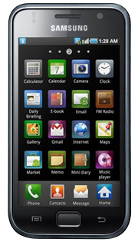

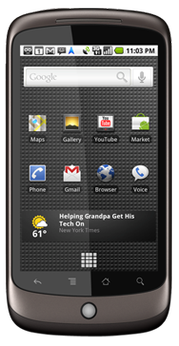
Lots of Different Devices

Slide 68
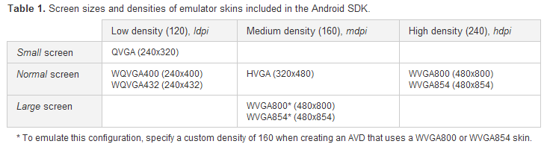
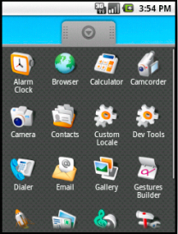
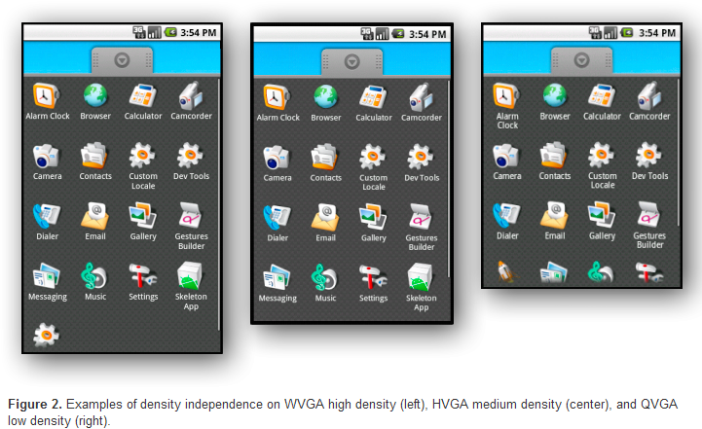
Multiple Screen Support

Slide 69
Manifest file
The Manifest file contains information about
  Activities – screens that are part of your app
    Also defines the entry point activity
  Permissions – all the special permissions required by the app
    E.g. accessing the network, sms, etc
Can access the stuff in the /res by using the @ marker

Slide 70
Sample
<?xml version="1.0" encoding="utf-8"?>
<manifest xmlns:android="http://schemas.android.com/apk/res/android"
package="admu.edu.cs119"
android:versionCode="1"
android:versionName="1.0">
<uses-sdk android:minSdkVersion="8" />
<application android:icon="@drawable/icon" android:label="@string/app_name">
<activity android:name=".HelloWorldActivity"
android:label="@string/app_name">
<intent-filter>
<action android:name="android.intent.action.MAIN" />
<category android:name="android.intent.category.LAUNCHER" />
</intent-filter>
</activity>
</application>
</manifest>
This intent-filter marks the entry point of your application

Slide 71
Activities
Activities define the available screens that will be used in the your application
Activities have complex life-cycles that are controlled by events that occur on the phone such as being put in the background, calls, changing orientation, etc.
  onCreate() is the life-cycle method for initializing the activity
  More on Activities later

Slide 72
Customizing HelloWorld
Quickest way to customize HelloWorld is to change the widgets inside it
Editing XML layout is one way to achieve this
Another is to programmatically instantiate a view (like a TextField) and use it as the contentView

Slide 73
Programmatic customization
public class HelloWorldActivity extends Activity {
/** Called when the activity is first created. */
@Override
public void onCreate(Bundle savedInstanceState) {
super.onCreate(savedInstanceState);
//setContentView(R.layout.main);
TextView tv = new TextView(this);
tv.setText("*\n*\n**\n***");
setContentView(tv);
}
}

Slide 74
Coming Soon
Making your own UI
Handling user input

